Slide 1
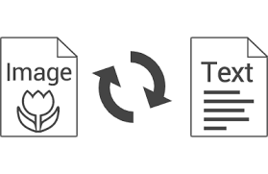
ASHA SANDEEP
NOIDA
DIGICHROME ACADEMY
Project-10
submission date:-20th march,2025
To Nexthikes@info

Slide 2
Objective
The objective of this OCR (Optical Character Recognition) project is to develop a Streamlit-based web application that allows users to extract text from images using EasyOCR. The app enhances text recognition through image preprocessing, including grayscale conversion, resizing, Gaussian blur, and bounding box visualization around detected text.

Slide 3
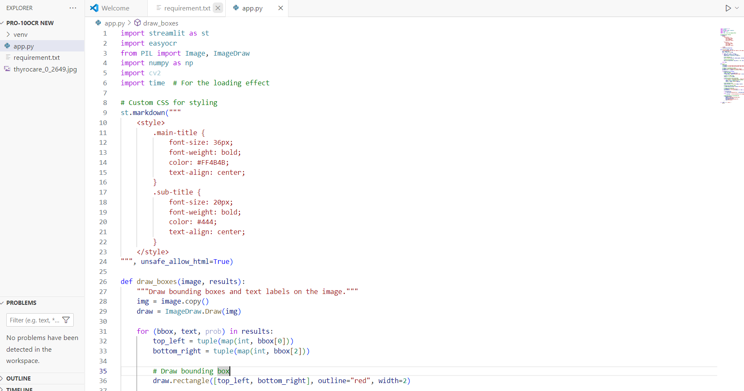
STEP 1 Install required liabraries
Run the following commands in your terminal:
bash
pip install streamlit easyocr numpy opencv-python pillow
If pip is not recognized, try:
bash
python -m pip install streamlit easyocr numpy opencv-python pillow

Slide 4
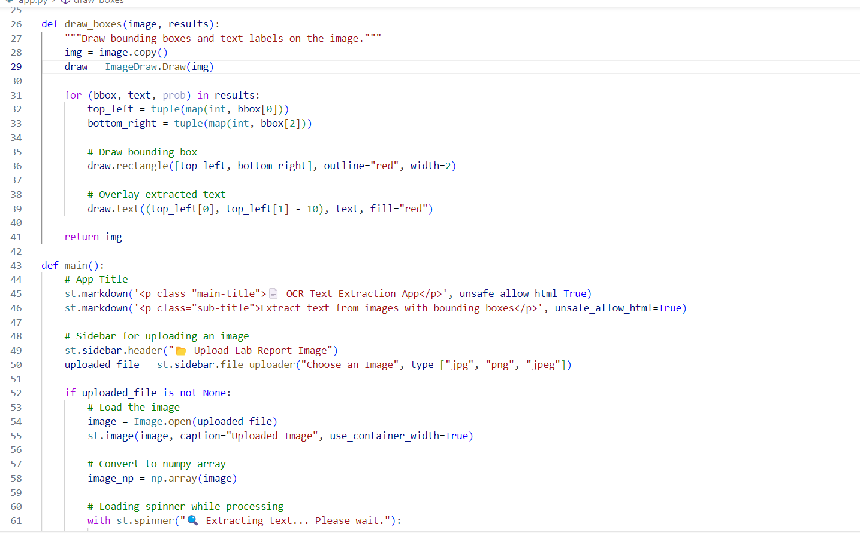
STEP 2 writing the python codes
1 Import required libraries
2 Create a function to draw bounding boxes
3 Load and process the image using EasyOCR
4 Display extracted text and allow download

Slide 5
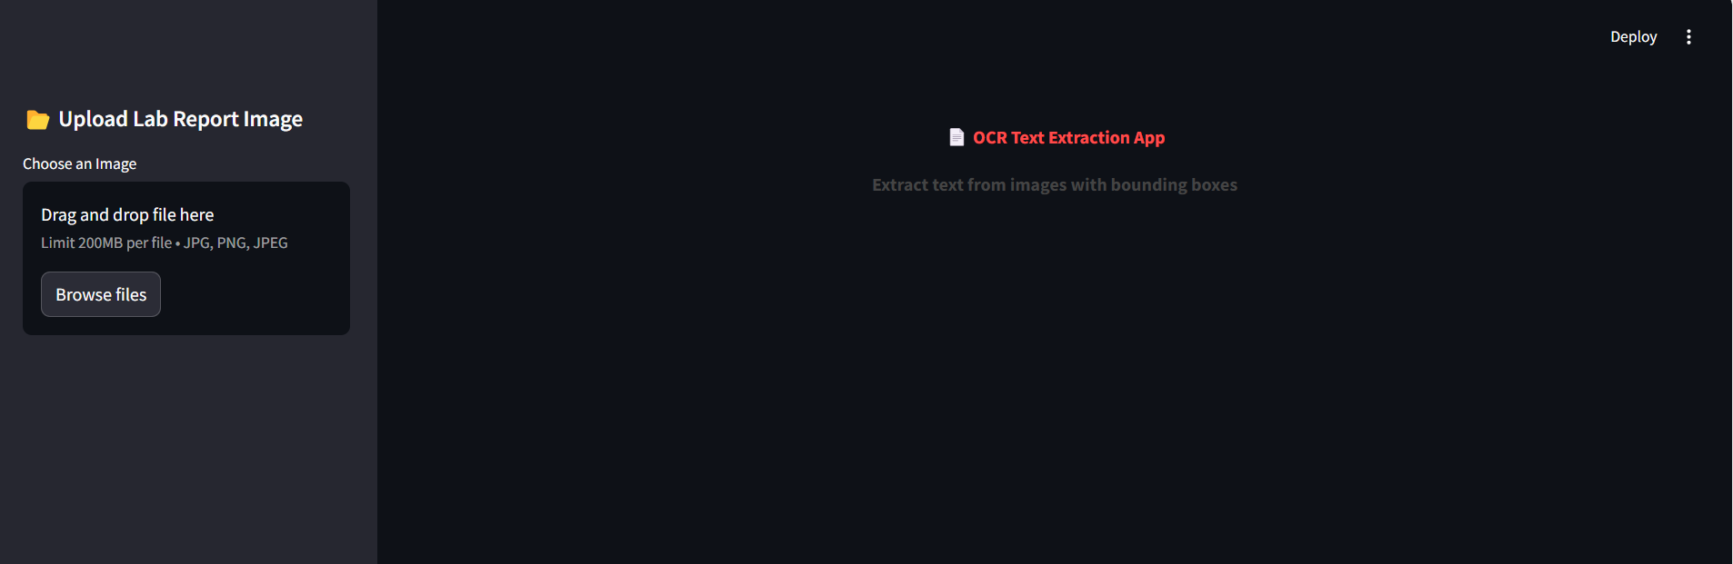
STEP-3 writing the code
import streamlit as st
import easyocr
from PIL import Image, ImageDraw
import numpy as np
def main():
st.title('OCR Text Extraction')
uploaded_file = st.file_uploader('Upload an Image')
STEP-4To launch my Streamlit OCR app
streamlit run app.py
You can now view your Streamlit app in your browser.
http://localhost:8501/

Slide 6
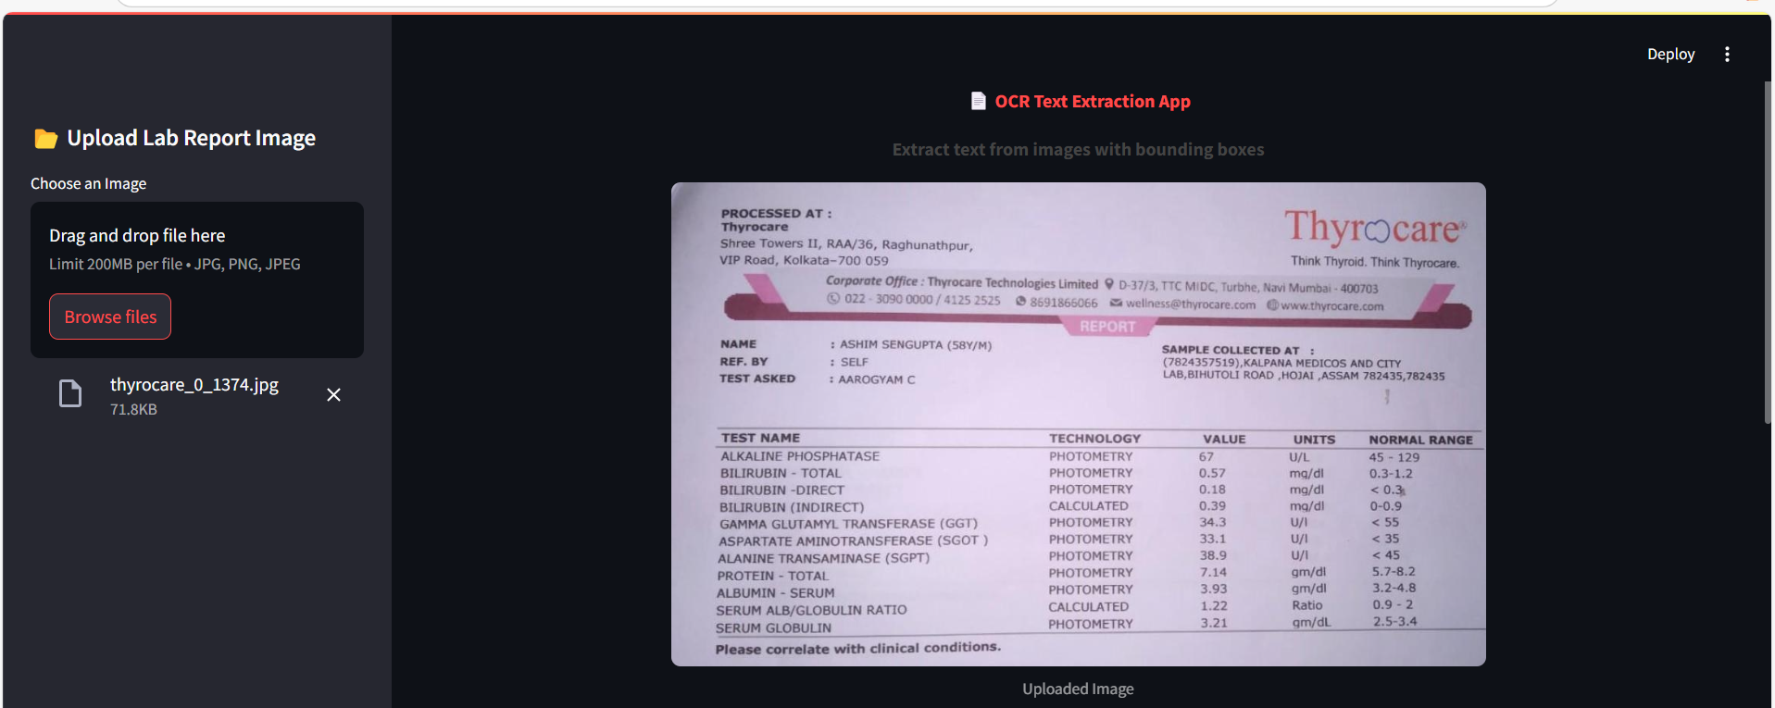
Here I click the browse files button and uplaod the image from folder where i store my dataset and the image show in this page.

Slide 7
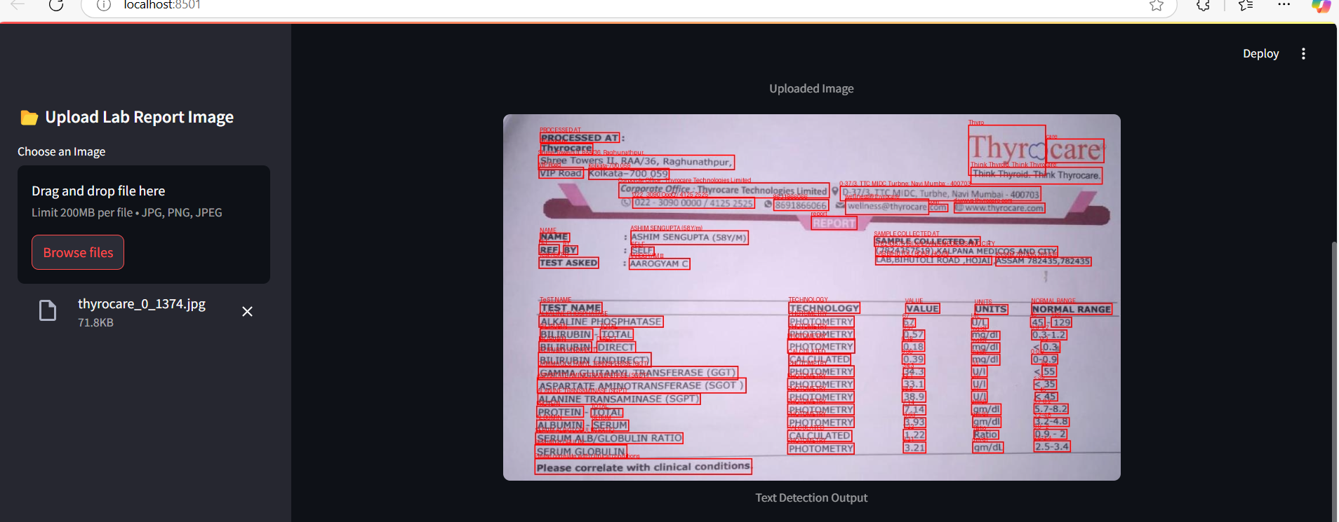
After uploaded image’s text will detected and Text Detection output will show here by creating the bounding box on all text.

Slide 8
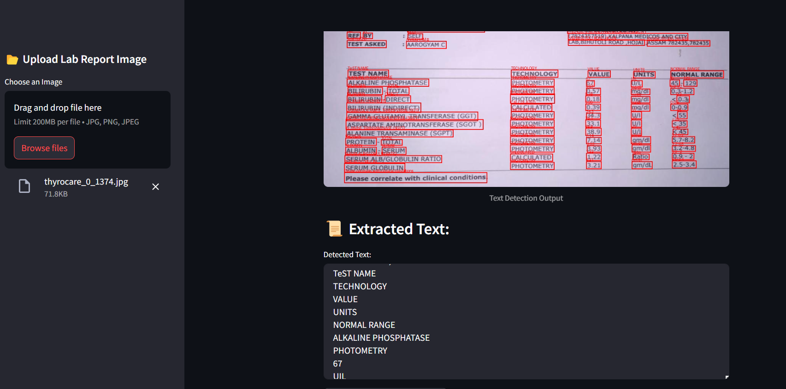
In this pic text detected and and show clearly we have to scroll here to show to text.

Slide 9
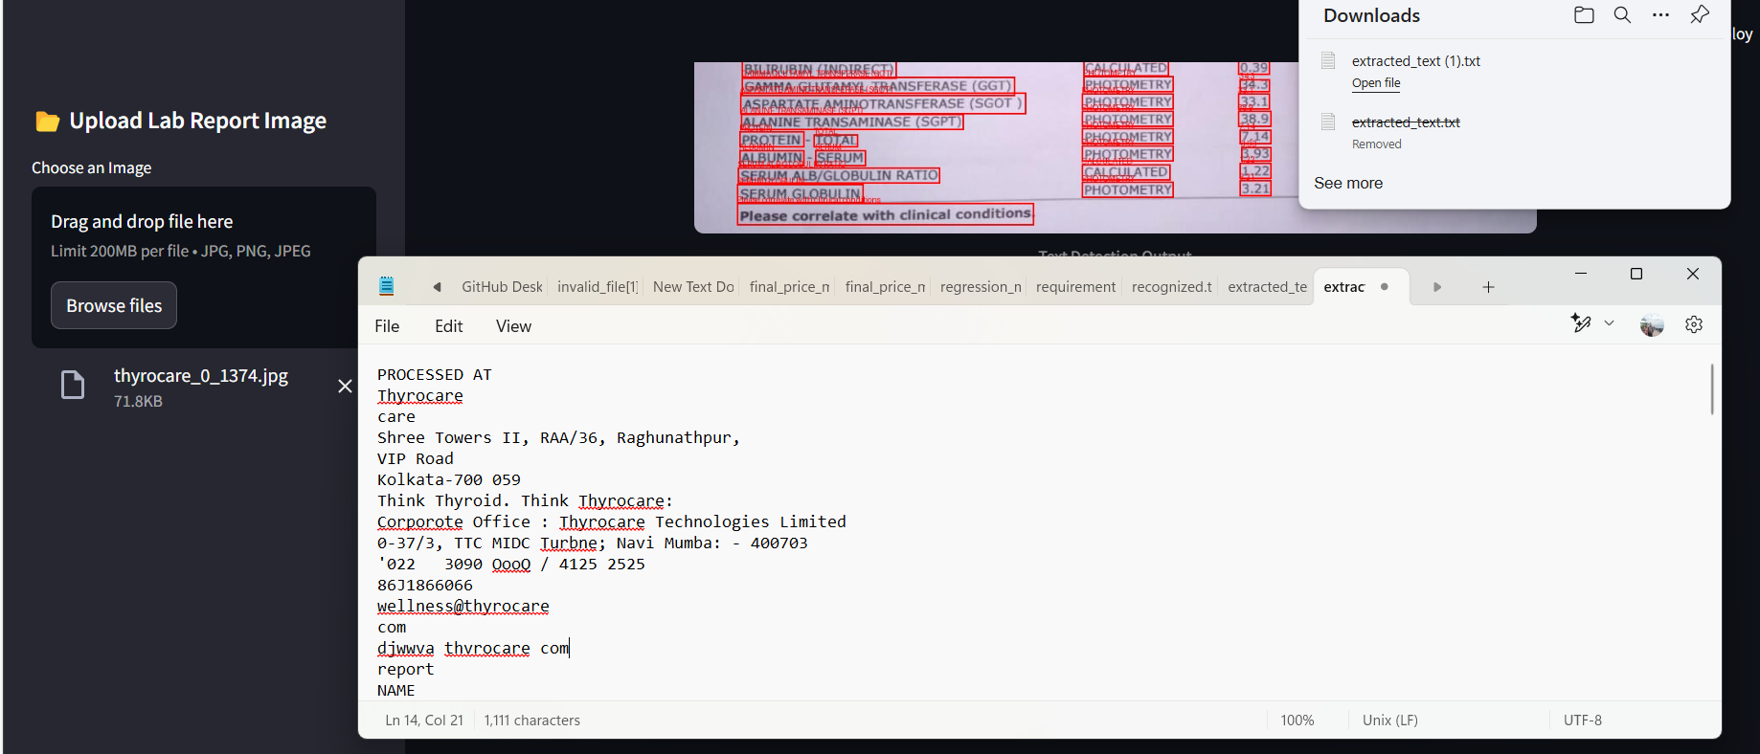
I have created on button of download the extracted text in text file here we can also edit the text and save the file in any where option will get.

Slide 10
Challenges faced
I faced challenges
Image Quality Issues
Noisy Background & Complex Layouts
Preprocessing Difficulties
Bounding Box Accuracy
OCR Engine Limitations only 200MB per file

Slide 11
Solution
I got the solution from geeks for geeks,You tube .

Slide 12
Results and achievement
My Streamlit OCR App is ready! I can try uploading different images and testing the text extraction.but the limit is only 200 MB per file.

Slide 13
Conclusion
This OCR project provides an easy-to-use interface for extracting text from images using EasyOCR and OpenCV. It includes preprocessing steps to improve text recognition accuracy and offers a user-friendly way to download extracted text.

Slide 14


